Slide 3
Resurrection Sunday
Resurrection Sunday

Slide 4
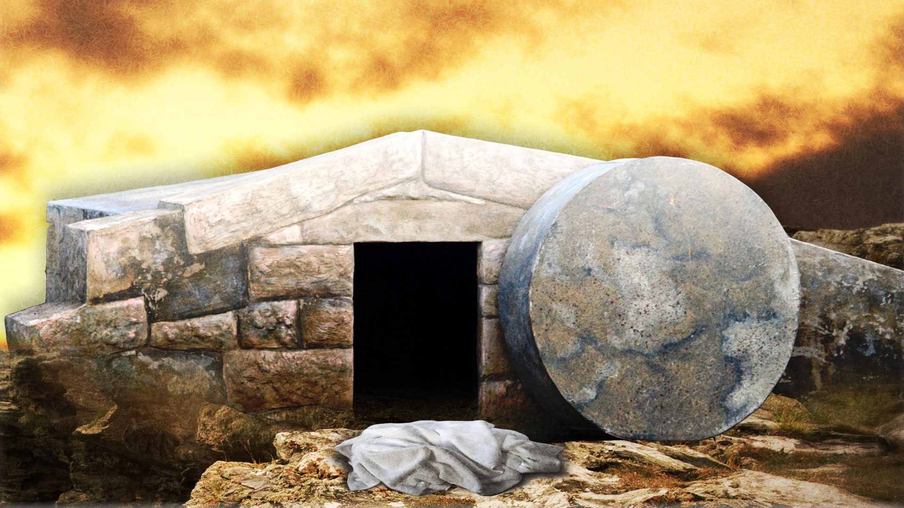
A Three-Fold Invitation
Resurrection Sunday

Slide 5
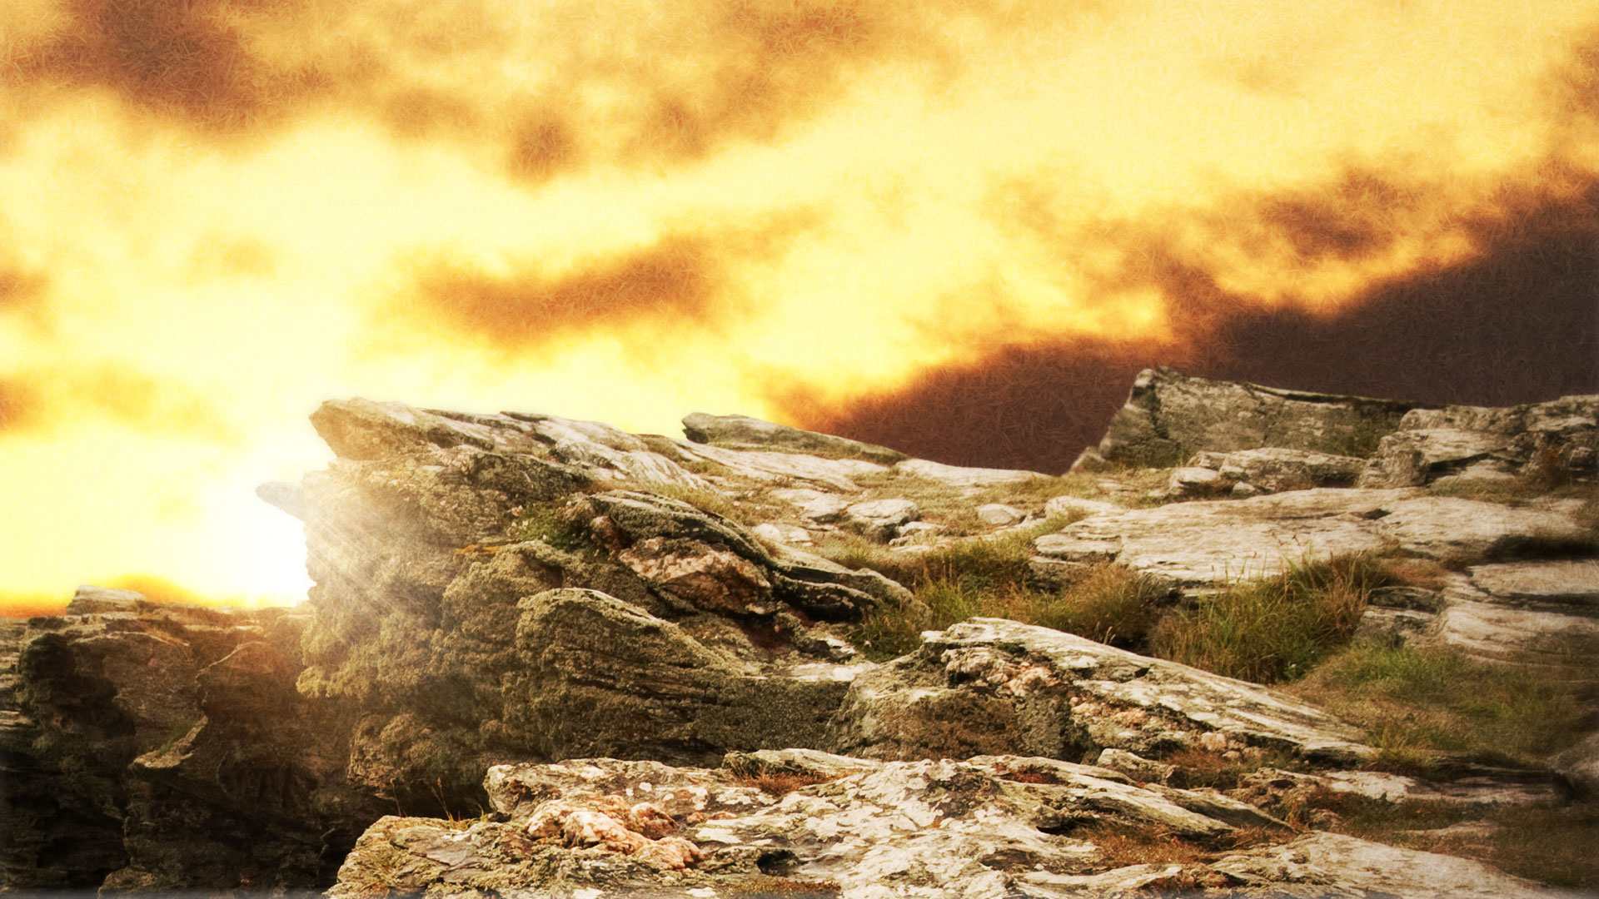
A Three-Fold Invitation
An Invitation that hinges
on our boldness

Slide 6
A boldness that rests on
the finished work of Jesus Christ

Slide 7
19 Therefore, brothers, since we have confidence
Hebrews 10

Slide 8
19 Therefore, brothers, since we have confidence (boldness)
Hebrews 10

Slide 9
19 Therefore,
Hebrews 9-10:18
The Superior Sacrifice of
Jesus Christ
Hebrews 10

Slide 10
19 Therefore, brothers, since we have confidence to enter the Most Holy Place by the blood of Jesus,
Hebrews 10

Slide 11
20 by a new and living way opened for us through the curtain,
Hebrews 10

Slide 12
With a loud cry, Jesus breathed his last. The curtain of the temple was torn in two from top to bottom
Mark 15:37-38

Slide 13
20 by a new and living way opened for us through the curtain, that is, his body,
Hebrews 10

Slide 14
21 and since we have a great priest over the house of God,
Hebrews 10

Slide 15
Jesus answered, "I am the way and the truth and the life. No one comes to the Father except through me.”
John 14:6

Slide 16
“But God raised him from the dead, freeing him from the agony of death, because it was impossible for death to keep its hold on him.” Acts 2:24

Slide 17
Five Proofs

Slide 18
Five Proofs
Change In Disciples

Slide 19
“Perhaps the transformation of the disciples is the greatest evidence of all for the resurrection…

Slide 20
When Jesus died, they were heartbroken, confused and frightened.

Slide 21
But within less than two months they came out of hiding, full of joy, confidence and courage.

Slide 22
What can account for this dramatic transformation?

Slide 23
Only the resurrection, together with Pentecost which followed soon afterwards.”
~ John Stott

Slide 24
Five Proofs
Change In Disciples
Eyewitness Accounts

Slide 25
“God has raised this Jesus to life, and we are all witnesses of the fact.
Acts 2:32

Slide 26
Five Proofs
Change In Disciples
Eyewitness Accounts
Over 500 witnesses

Slide 27
Five Proofs
Change In Disciples
Eyewitness Accounts
Over 500 witnesses
Groups & Individuals

Slide 28
Five Proofs
Change In Disciples
Eyewitness Accounts
Modern Day Accounts

Slide 29
“I had read just enough philosophy and history to find support for my skepticism—

Slide 30
- a fact here, a scientific theory there, a pithy quote, a clever argument.

Slide 31
Sure, I could see some gaps and inconsistencies, but I had a strong motivation to ignore them:

Slide 32
a self-serving and immoral lifestyle that I would be compelled to abandon if I were ever to change my views and become a follower of Jesus.”
~ Lee Strobel

Slide 33
Five Proofs
Change In Disciples
Eyewitness Accounts
Modern Day Accounts
Lee Strobel: “The Case For Christ”

Slide 34
Five Proofs
Change In Disciples
Eyewitness Accounts
Modern Day Accounts
Leaders Couldn’t Disprove

Slide 35
Five Proofs
Change In Disciples
Eyewitness Accounts
Modern Day Accounts
Leaders Couldn’t Disprove
Disciples Willing To Die

Slide 36
Five Proofs
Change In Disciples
Eyewitness Accounts
Modern Day Accounts
Leaders Couldn’t Disprove
Disciples Willing To Die

Slide 37
19 Therefore,
Hebrews 10

Slide 38
19 Therefore, brothers, since we have confidence
Hebrews 10

Slide 39
Three-Fold Invitation

Slide 40
22 let us draw near to God
Hebrews 10

Slide 41
Three-Fold Invitation
Let us draw near

Slide 42
Three-Fold Invitation
Let us draw near
Open Invitation

Slide 43
Three-Fold Invitation
Let us draw near
Open Invitation
OT Priests “visited” the Holy of Holies” once a year

Slide 44
Three-Fold Invitation
Let us draw near
Open Invitation
OT Priests “visited” the Holy of Holies” once a year
We get to dwell in His presence

Slide 45
22 let us draw near to God with a sincere heart in full assurance of faith,
Hebrews 10

Slide 46
Three-Fold Invitation
Let us draw near
It takes preparation!

Slide 47
5 This is the message we have heard from him and declare to you: God is light; in him there is no darkness at all.
1 John 1:5-2:2

Slide 48
6 If we claim to have fellowship with him yet walk in the darkness, we lie and do not live by the truth.
1 John 1:5-2:2

Slide 49
7 But if we walk in the light, as he is in the light, we have fellowship with one another, and the blood of Jesus, his Son, purifies us from all sin.
1 John 1:5-2:2

Slide 50
8 If we claim to be without sin, we deceive ourselves and the truth is not in us.
1 John 1:5-2:2

Slide 51
9 If we confess our sins, he is faithful and just and will forgive us our sins and purify us from all unrighteousness.
1 John 1:5-2:2

Slide 52
10 If we claim we have not sinned, we make him out to be a liar and his word has no place in our lives.
1 John 1:5-2:2

Slide 53
1 My dear children, I write this to you so that you will not sin. But if anybody does sin, we have one who speaks to the Father in our defense — Jesus Christ, the Righteous One.
1 John 1:5-2:2

Slide 54
2 He is the atoning sacrifice for our sins, and not only for ours but also for the sins of the whole world.
1 John 1:5-2:2

Slide 55
Three-Fold Invitation
Let us draw near

Slide 56
Three-Fold Invitation
Let us draw near
Let us hold unswervingly

Slide 57
23 Let us hold unswervingly to the hope we profess,
Hebrews 10

Slide 58
Three-Fold Invitation
Let us draw near
Let us hold unswervingly
to our HOPE

Slide 59
23 Let us hold unswervingly to the hope we profess, for he who promised is faithful.
Hebrews 10

Slide 60
Three-Fold Invitation
Let us draw near
Let us hold unswervingly
Let us consider one another

Slide 61
24 And let us consider how we may spur one another on toward love and good deeds.
Hebrews 10

Slide 62
25 Let us not give up meeting together, as some are in the habit of doing, but let us encourage one another -
Hebrews 10

Slide 63
Three-Fold Invitation
Let us draw near
Let us hold unswervingly
Let us consider one another
It’s not about what WE GET, but what WE GIVE

Slide 64
Three-Fold Invitation
Let us draw near
Let us hold unswervingly
Let us consider one another
Faithful attendance encourages and motivates

Slide 65
Three-Fold Invitation
Let us draw near
Let us hold unswervingly
Let us consider one another
Biblical love is not acting like we feel: it’s obeying God’s commands

Slide 66
And this is love: that we walk in obedience to his commands.
2 John 1:6

Slide 67
Three-Fold Invitation
Let us draw near
Let us hold unswervingly
Let us consider one another
FAITH
HOPE
LOVE

Slide 68
And now these three remain: faith, hope and love. But the greatest of these is love.
1 Corinthians 13:13

Slide 69
25 Let us not give up meeting together, as some are in the habit of doing, but let us encourage one another -
“assembling”
Hebrews 10

Slide 70
Concerning the coming of our Lord Jesus Christ and our being gathered to him
2 Thessalonians 2:1
“assembling”

Slide 71
Concerning the coming of our Lord Jesus Christ and our being gathered to him
2 Thessalonians 2:1

Slide 72
25 Let us not give up meeting together, as some are in the habit of doing, but let us encourage one another -
Hebrews 10

Slide 73
25b— and all the more as you see the Day approaching.
Hebrews 10

