Slide 1
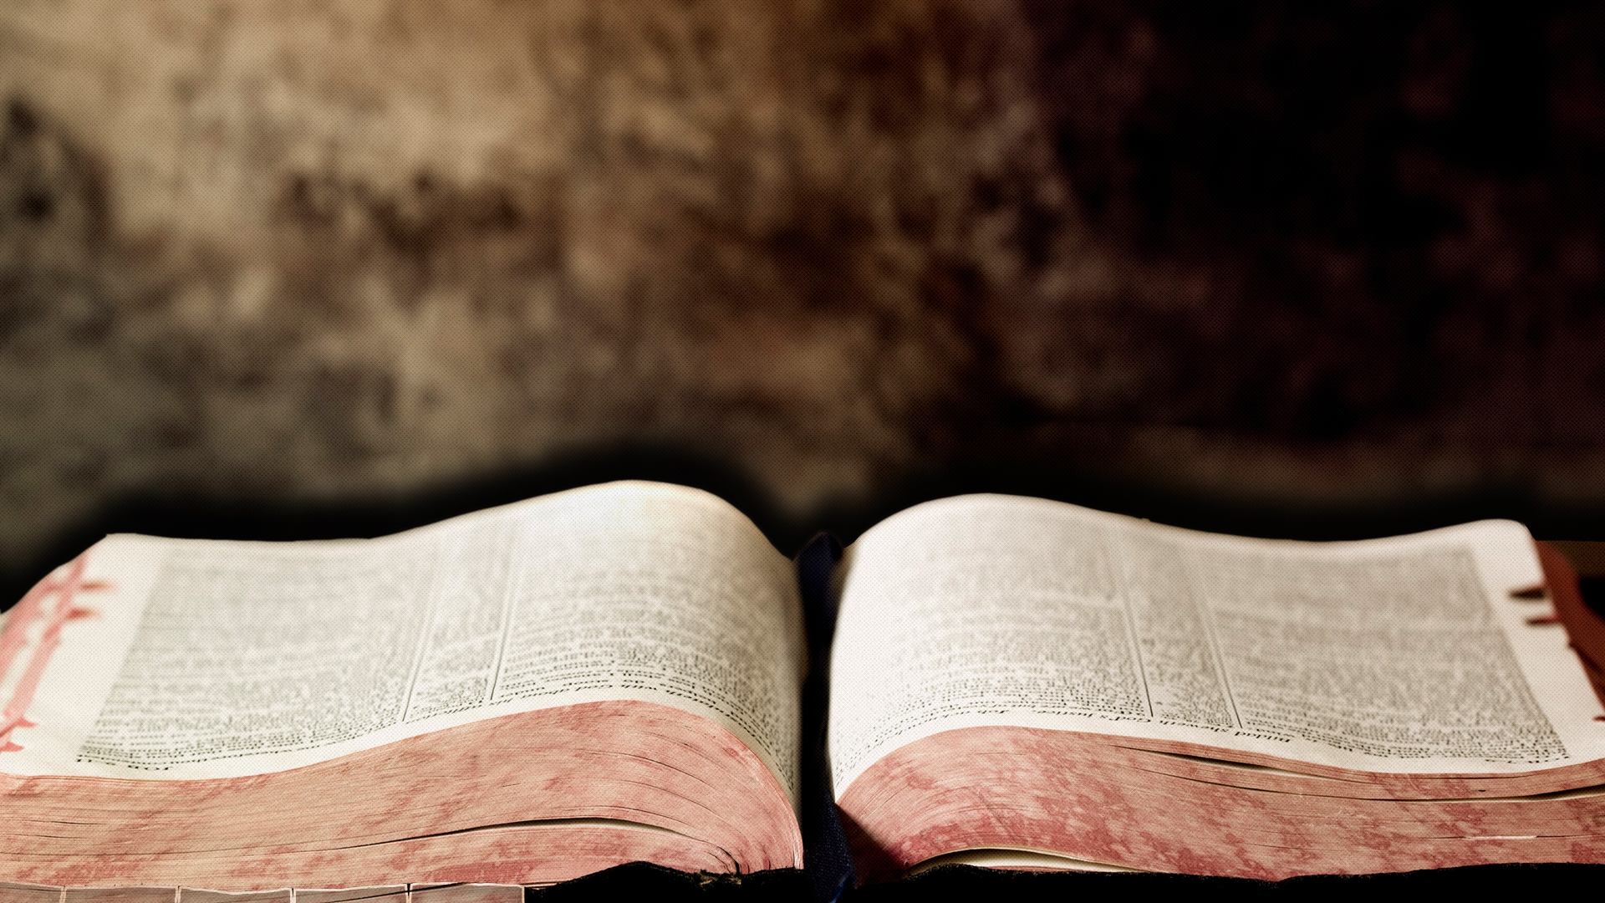
HEBREWS
The Person & Works of Jesus Christ

Slide 2
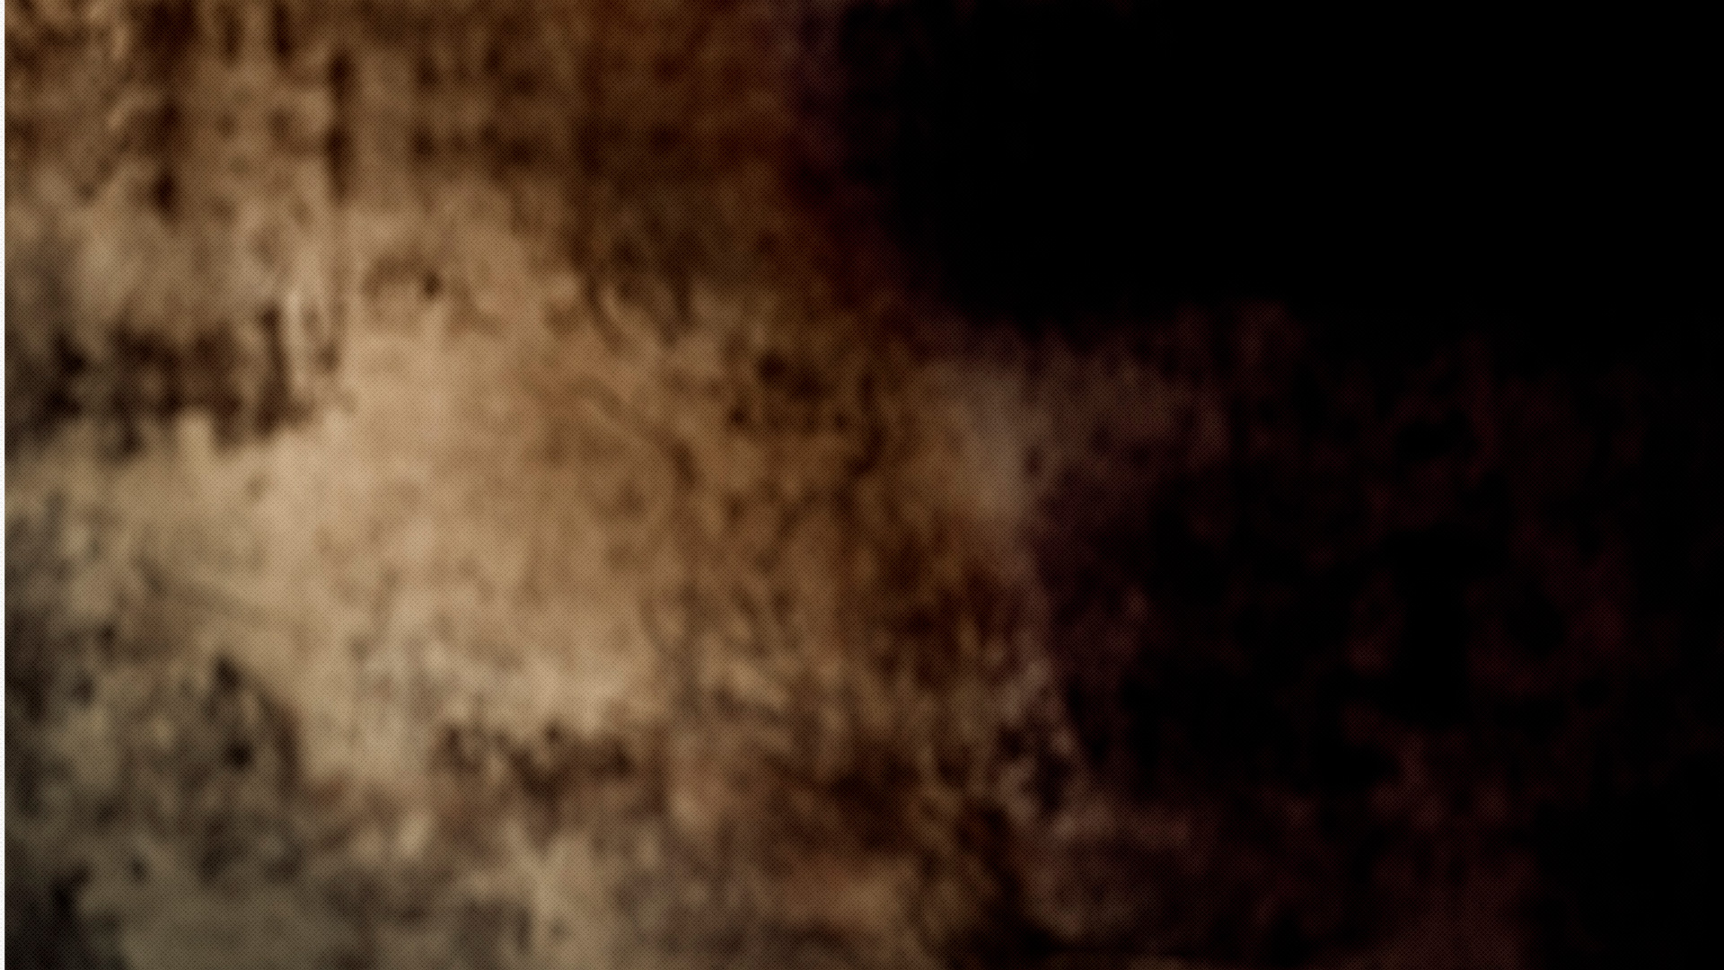
A Superior Person:
Jesus Christ
BETTER
Hebrews 1-6
A Superior Priesthood:
Jesus Christ
Hebrews 7-10

Slide 3
A Superior Person:
Jesus Christ
BETTER
How do we respond?
A Superior Priesthood:
Jesus Christ

Slide 4
A Superior Person:
Jesus Christ
BETTER
Growing in Faith
A Superior Priesthood:
Jesus Christ

Slide 5
got faith?

Slide 6
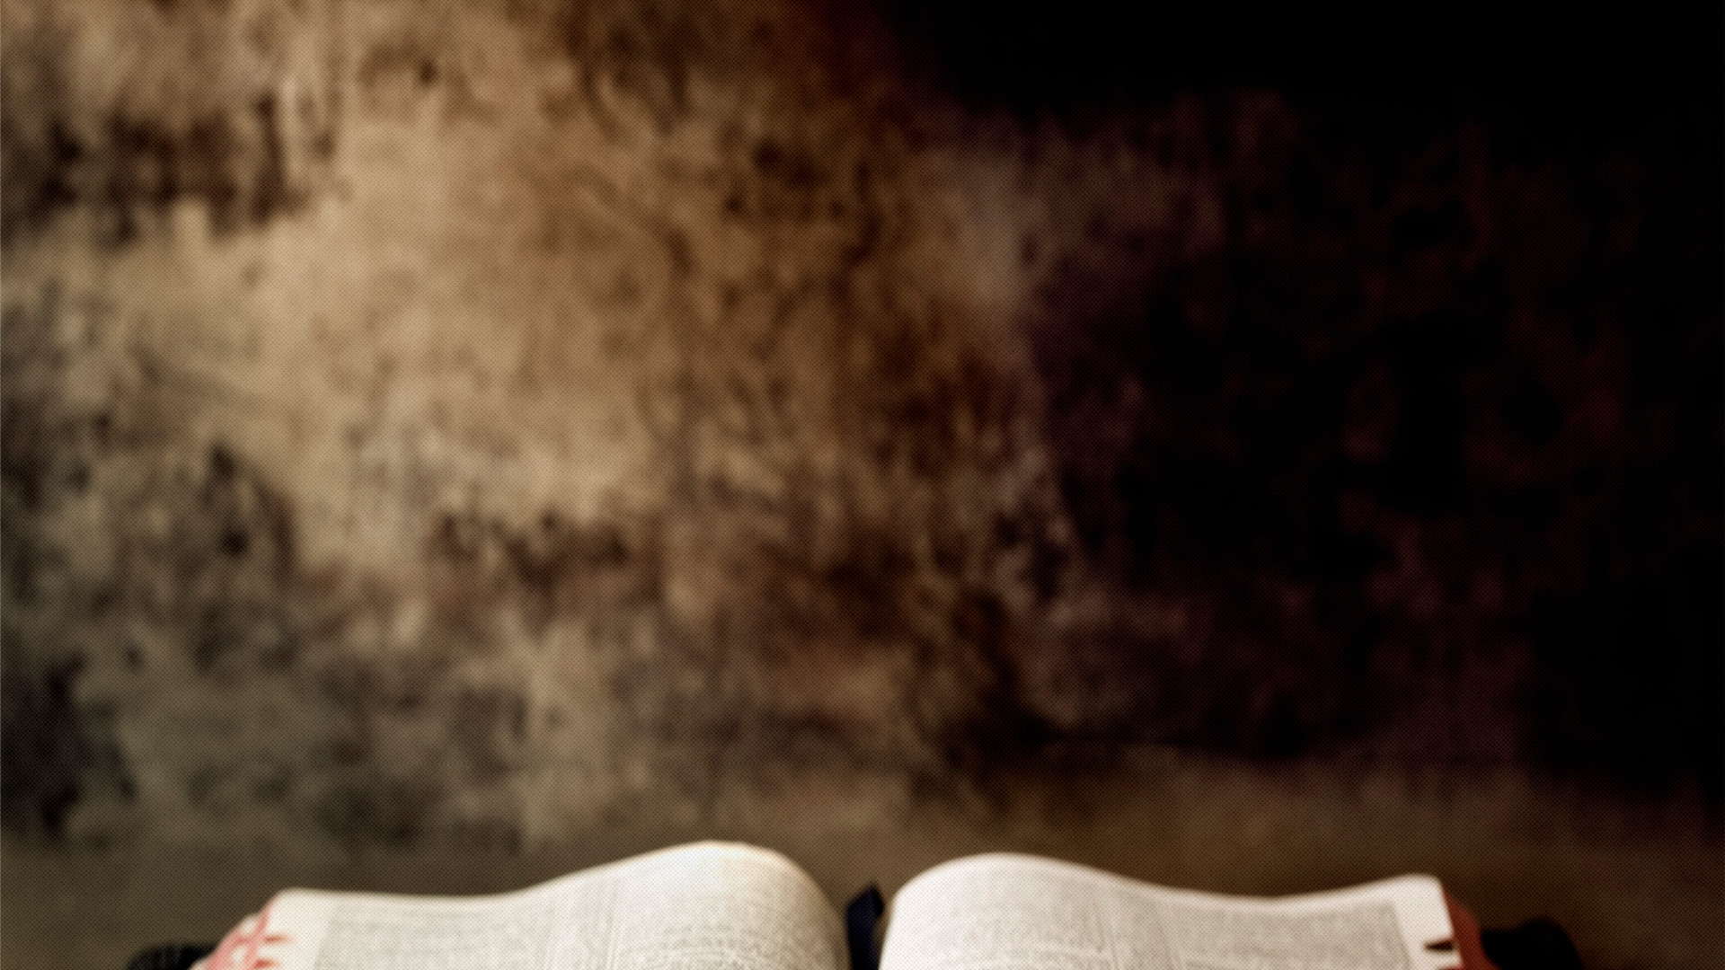
Hebrews 10
32 Remember those earlier days after you had received the light, when you endured in a great conflict full of suffering.

Slide 7
Hebrews 10
33 Sometimes you were publicly exposed to insult and persecution; at other times you stood side by side with those who were so treated.

Slide 8
Hebrews 10
34 You suffered along with those in prison and joyfully accepted the confiscation of your property,

Slide 9
Hebrews 10
34b because you knew that you yourselves had better and lasting possessions

Slide 10
Hebrews 10
35 So do not throw away your confidence; it will be richly rewarded.

Slide 11
got faith?

Slide 12
Hebrews 11
1 Now faith is the substance of things hoped for, the evidence of things not seen KJV

Slide 13
True Bible faith is
confident obedience
to Gods Word in spite of circumstances and consequences
motivated by seeking & desiring something not available now

Slide 14
Hebrews 11
6 And without faith it is impossible to please God,

Slide 15
got faith?
What kind of faith does it take to please God?

Slide 16
Hebrews 11
6b because anyone who comes to him must believe that he exists and that he rewards those who earnestly seek him.

Slide 17
got faith?
the type that would make God say, “I am proud to be your God because you seek after Me and My promises despite your situation”

Slide 18
got faith?
What kind of faith does it take to please God?
One that seeks God & His Promises

Slide 19
got faith?
The kind of faith that can endure,
not necessarily escape?

Slide 20
Hebrews 10
36 You need to persevere so that when you have done the will of God, you will receive what he has promised.

Slide 21
got faith?
Hebrews 11: A chapter that describes faith, and illustrates, through many examples they kind of faith that pleases God

Slide 22
Romans 15:4
For everything that was written in the past was written to teach us, so that through the endurance taught in the Scriptures and the encouragement they provide we might have hope.

Slide 23
HEBREWS
Chap 12
FAITH ACTION
PLAN

Slide 24
ENDURANCE
throw off
consider
pursue
FAITH ACTION
PLAN
make straight
run
strengthen
ATTITUDE
endure
don’t refuse
set sights

Slide 25
ENDURANCE
TO STAY IN THE RUNNING!

Slide 26
Stay In The Running:
The Resources
The Example Of God’s Son
The Assurance of God’s Love
The Enablement of God’s Grace

Slide 27
The Example Of God’s Son

Slide 28
The Example Of God’s Son
Look at the witnesses

Slide 29
Hebrews 12
1 Therefore, since we are surrounded by such a great cloud of witnesses,

Slide 30
The Example Of God’s Son
Look at the witnesses
  Not a “heavenly” audience
  Their lives bear witness that God will see you through

Slide 31
The Example Of God’s Son
Look at the witnesses
Look at yourself

Slide 32
Hebrews 12
1b let us throw off everything that hinders and the sin that so easily entangles,

Slide 33
The Example Of God’s Son
Look at the witnesses
Look at yourself
  What hinders?

Slide 34
The Example Of God’s Son
Look at the witnesses
Look at yourself
  What hinders?
  Sometimes, we lose sight of the more relevant questions:

Slide 35
We tend to ask, “what’s wrong with this or that? The BETTER question: is it in the way of greater...
self control?
faith?
love?
humility?
courage?
generosity?
patience?
fellowship of believers?

Slide 36
Hebrews 12
1b let us throw off everything that hinders and the sin that so easily entangles,

Slide 37
The Example Of God’s Son
Look at the witnesses
Look at yourself
  What hinders?
  Areas of sin?

Slide 38
Hebrews 12
1c and let us run with perseverance the race marked out for us.

Slide 39
The Example Of God’s Son
Look at the witnesses
Look at yourself
  What hinders?
  Areas of sin?
  How do you respond (react)?

Slide 40
The Example Of God’s Son
Look at the witnesses
Look at yourself
Look at Jesus!

Slide 41
Hebrews 12
2 Let us fix our eyes on Jesus, the author and perfecter of our faith,

Slide 42
Hebrews 12
2b who for the joy set before him endured the cross, scorning its shame, and sat down at the right hand of the throne of God.

Slide 43
got faith?
What kind of faith does it take to please God?
One that seeks God & His Promises

Slide 44
True Bible faith is
confident obedience
to Gods Word in spite of circumstances and consequences
motivated by seeking & desiring something not available now

Slide 45
Stay In The Running:
The Resources
The Example Of God’s Son
The Assurance of God’s Love

Slide 46
The Assurance of God’s Love

Slide 47
Hebrews 12
3 Consider him who endured such opposition from sinful men, so that you will not grow weary and lose heart.

Slide 48
Hebrews 12
4 In your struggle against sin, you have not yet resisted to the point of shedding your blood.

Slide 49
Hebrews 12
5 And have you completely forgotten this word of encouragement that addresses you as a father addresses his son? It says,

Slide 50
Hebrews 12
5b “My son, do not make light of the Lord’s discipline,
and do not lose heart when he rebukes you,

Slide 51
The Assurance of God’s Love
Discipline is not same as punishment

Slide 52
Hebrews 12
6 because the Lord disciplines the one he loves,
and he chastens everyone he accepts as his son.”

Slide 53
Hebrews 12
7 Endure hardship as discipline; God is treating you as his children. For what children are not disciplined by their father?

Slide 54
The Assurance of God’s Love
Discipline is not same as punishment
Reason for discipline

Slide 55
Hebrews 12
10 They disciplined us for a little while as they thought best; but God disciplines us for our good, in order that we may share in his holiness.

Slide 56
Hebrews 12
11 No discipline seems pleasant at the time, but painful.

Slide 57
Hebrews 12
11b Later on, however, it produces a harvest of righteousness and peace for those who have been trained by it.

Slide 58
Hebrews 12
11b Later on, however, it produces a harvest of righteousness and peace for those who have been trained by it.

Slide 59
Hebrews 12
14 Make every effort to live in peace with everyone and to be holy; without holiness no one will see the Lord.

Slide 60
Hebrews 12
7 Endure hardship as discipline; God is treating you as his children. For what children are not disciplined by their father?

Slide 61
Hebrews 10
36 You need to persevere so that when you have done the will of God, you will receive what he has promised.

Slide 62
ENDURANCE
TO STAY IN THE RUNNING!

Slide 63
Hebrews 12
12 Therefore, strengthen your feeble arms and weak knees. 13 “Make level paths for your feet,” so that the lame may not be disabled, but rather healed.

Slide 64
Stay In The Running:
The Resources
The Example Of God’s Son
The Assurance of God’s Love
The Enablement of God’s Grace

Slide 65
Hebrews 12
15 See to it that no one falls short of the grace of God and that no bitter root grows up to cause trouble and defile many.

Slide 66
The Enablement of God’s Grace
Look Back

Slide 67
Hebrews 12
16 See that no one is sexually immoral, or is godless like Esau, who for a single meal sold his inheritance rights as the oldest son.

Slide 68
The Enablement of God’s Grace
Look Back What blessings are willing to trade for an escape from your current circumstance? What makes up your bowl of stew?

Slide 69
The Enablement of God’s Grace
Look Back
Look Up

Slide 70
Hebrews 12
18 You have not come to a mountain that can be touched and that is burning with fire; to darkness, gloom and storm;

Slide 71
Hebrews 12
22 But you have come to Mount Zion, to the city of the living God, the heavenly Jerusalem.

Slide 72
Hebrews 12
22b You have come to thousands upon thousands of angels in joyful assembly,

Slide 73
Hebrews 12
23 to the church of the firstborn, whose names are written in heaven.

Slide 74
Hebrews 12
23b You have come to God, the Judge of all, to the spirits of the righteous made perfect,

Slide 75
Hebrews 12
24 to Jesus the mediator of a new covenant, and to the sprinkled blood that speaks a better word than the blood of Abel.

Slide 76
The Enablement of God’s Grace
Look Back
Look Up
Look Ahead

Slide 77
The Enablement of God’s Grace
Look Back
Look Up
Look Ahead
  But take care for this final warning…

Slide 78
Five Warnings
Drifting
Doubting
Dullness
Despising
2:1-4
3:7-4:13
5:11-6:20
10:26-39

Slide 79
Five Warnings
Drifting
Doubting
Dullness
Despising
Defying
2:1-4
3:7-4:13
5:11-6:20
10:26-39
12:14-29

Slide 80
Hebrews 12
25 See to it that you do not refuse him who speaks. If they did not escape when they refused him who warned them on earth,

Slide 81
Hebrews 12
26 At that time his voice shook the earth, but now he has promised, “Once more I will shake not only the earth but also the heavens.”

Slide 82
Hebrews 12
27 The words “once more” indicate the removing of what can be shaken—that is, created things—so that what cannot be shaken may remain.

Slide 83
The Enablement of God’s Grace
Look Back
Look Up
Look Ahead

Slide 84
Hebrews 12
28 Therefore, since we are receiving a kingdom that cannot be shaken,

Slide 85
Hebrews 12
28b let us be thankful, and so worship God acceptably with reverence and awe,

Slide 86
The Enablement of God’s Grace
Look Back
Look Up
Look Ahead
  Causes us to assemble to worship & serve out of awe

Slide 87
Hebrews 12
28b let us be thankful, and so worship God acceptably with reverence and awe,
29 for our “God is a consuming fire.”

Slide 88
The Enablement of God’s Grace
Look Back
Look Up
Look Ahead
  Causes us to understand He refines our gold!

Slide 89
got faith?
The kind it takes to please God?
One that seeks God & His Promises
RUNS AFTER!

Slide 90
got endurance?
motivated by His example of perseverance?
do you trust His love for you in
your circumstances?
do you look for His enabling grace?

Slide 91
HEBREWS
Chap 12
FAITH ACTION
PLAN

